Slide 1
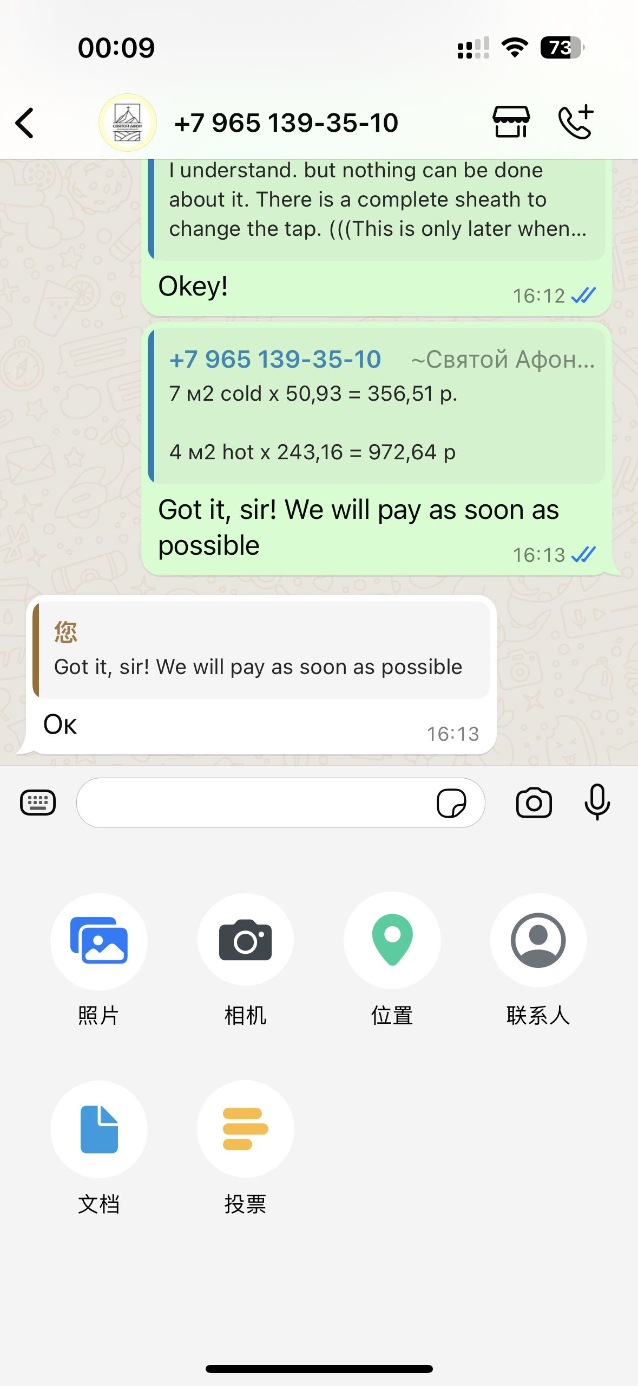
i
Process percentage
Start
Pause
Clear
Export Pictures
Export PDF
Videos
Camera
Files

